Slide 1
Advanced CPT (Java)
240-321, Semester 2, 2004-2005
3. Some Imperative Features
(Chapters 4-7, D&D)
Objectives
  consider C-like Java control structures, functions (methods), and arrays.

Slide 2
Contents
1. Control Structures (chs 4, 5)
2. Methods (functions) (ch. 6)
3. Packages
4. Arrays (ch. 7)

Slide 3
1. Control Structures D&D, ch.4,5
1.1. Looping
1.2. Branching
1.3. SwitchTest.java
1.4. Labelled Break
1.5. Labelled Continue

Slide 4
1.1. Looping
Same as in C:
  while()
  for()
  do/while()
  break
  continue

Slide 5
1.2. Branching
Same as in C:
  if()
  switch()
  conditional expression ? :

Slide 6
1.3. SwitchTest.java Fig. 5.7, p.170
// Drawing shapes inside a switch()
import java.awt.Graphics;
import javax.swing.*;
public class SwitchTest extends JApplet {
int choice; // a 'global' variable
public void init()
{ String input;
input = JOptionPane.showInputDialog(
"Enter 1 to draw lines\n" +
"Enter 2 to draw rectangles\n" +
"Enter 3 to draw ovals\n" );
choice = Integer.parseInt( input );
}

Slide 7
public void paint( Graphics g )
{ for ( int i = 0; i < 10; i++ ) {
switch( choice ) {
case 1:
g.drawLine( 10, 10, 250, 10 + i * 10 );
break;
case 2:
g.drawRect( 10 + i * 10, 10 + i * 10,
50 + i * 10, 50 + i * 10 );
break;
case 3:
g.drawOval( 10 + i * 10, 10 + i * 10,
50 + i * 10, 50 + i * 10 );
break;
default:
JOptionPane.showMessageDialog(
null, "Invalid value entered" );
} // end switch
} // end for
} // end paint()
} // end class SwitchTest

Slide 8
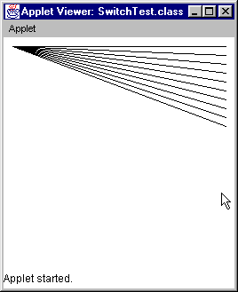
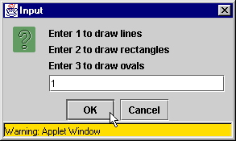
Use

Slide 9
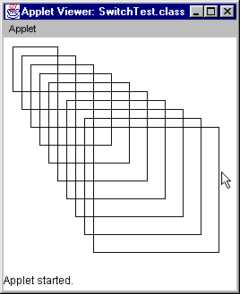
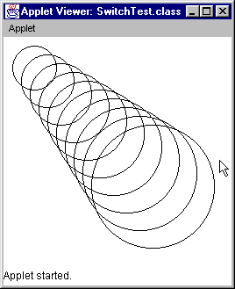

Slide 10
Notes
SwitchTest is an applet with one 'global' variable and two methods:
  choice
  init(), paint()
init() is another pre-specified applet method
  it is always called when an applet is first created
  it is often redefined to do initialisation tasks
continued

Slide 11
choice is 'global' means that:
  choice is visible to every method in the object/applet
    i.e. init() and paint()
  choice cannot be seen outside the object/applet
  choice must be ‘global’ since we cannot pass arguments into init(), paint() or other pre-defined methods.
continued

Slide 12
Graphics methods are described later:
  drawLine()
  drawRect()
  drawOval()
They draw into the graphics context of the applet, in the same way as drawString().

Slide 13
1.4. Labelled Break
Break out of a nested set of control structures (e.g. while, for, switch) to the named label.
  C-style break only breaks out one level

Slide 14
BreakLabelTest.java Fig. 5.13, p.179
:
public class BreakLabelTest {
public static void main (String args[])
{ :
stop: { // labeled compound statement
for ( int row = 1; row <= 10; row++ ){
for (int col = 1; col <= 5; col++) {
if (row == 5)
break stop;
// jump to end of stop block
:
}
}
} // end of stop block
:
Hardly ever
needed.

Slide 15
1.5. Labelled Continue
A labelled continue inside a loop control structure (e.g. for, while) causes execution to jump out of the nested loops to the next loop prefixed with the label.

Slide 16
ContinueLabelTest.java Fig. 5.14, p.181
:
public class ContinueLabelTest {
public static void main(String args[])
{ :
nextRow: // targetted for-loop
for ( int row = 1; row <= 5; row++ ) {
for (int col = 1; col <= 5; col++) {
if (col > row)
continue nextRow;
// jump to next iteration
:
}
}
:
AVOID
using this.

Slide 17
2. Methods (functions) Ch. 6
Methods are located inside classes
  in the Java class libraries (the Java API)
  in your own classes

Slide 18
Overview
2.1. Using Methods
2.2. Writing your own Methods
2.3. Parameter Passing
2.4. Java API Packages

Slide 19
2.1. Using Methods
1) Call a method in a class:
  double f;
  f = Math.sqrt(900.0);
  sqrt() is defined/implemented inside
  the Math class
continued

Slide 20
A Class is like a ‘Library’
Think of a class, such as Math, as a kind of library holding methods.
A class method usually takes input and returns an answer
  no change is made to the class
Math class
call
Hello
double sqrt(…)
{ … }
answer
f = Math.sqrt(900.0)

Slide 21
2) Call a method in an object
  Graphic g;
  g.drawString(“Hello”);
  affects the object g
  it means “send a drawString message to
  the g object”
  drawString() is defined/implemented inside the Graphic class
continued

Slide 22
An Object is like a ‘Data Holder’
An object contains data which is changed/accessed by a user calling its methods.
  drawString() affects the output stream stored inside g
g
call
Hello
g.drawString(…)
drawString()
alters the output
stream stored in g

Slide 23
2.2. Writing your own Methods
Define the class SquareInt, which contains two methods:
  init() // redefine an applet method
  square() // a new method

Slide 24
SquareInt.java Fig.6.3, p.207
import java.awt.Container;
import javax.swing.*;
public class SquareInt extends JApplet
{
public void init()
{ String output = ""; // default
JTextArea outputArea =
new JTextArea( 10, 20 );
// get applet's GUI display area
Container c = getContentPane();
// add outputArea to Container c
c.add( outputArea );
:

Slide 25
// build output string
int result;
for ( int x = 1; x <= 10; x++ ) {
result = square( x );
output += "The square of " + x +
" is " + result + "\n";
}
// put the string into the text area
outputArea.setText( output );
} // end of init()

Slide 26
// square method definition
private int square( int y )
{
return y * y;
}
} // end of SquareInt class

Slide 27
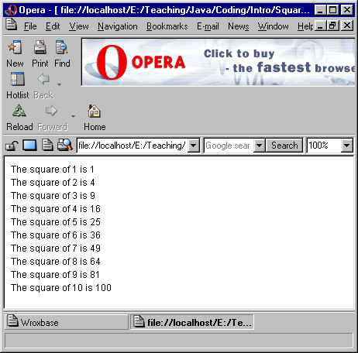
Output

Slide 28
Notes
The applet window is a container.
A textArea GUI element is added to it.
A output string is put inside the GUI element.
applet
container
The square of ...
:
:
textArea
String

Slide 29
2.3. Parameter Passing
In C all arguments are copied into functions:
  called call-by-value
Java uses call-by-value and call-by-reference.

Slide 30
What is Call-by-Reference?
An example for an imaginary language:
function foo()
begin
integer x := 2;
bar(x);
print(“x is” + x);
end
function bar(ref integer w)
begin
w := 5;
end
“x is 5” is printed
continued

Slide 31
Call-by-reference creates a link from the variable in the called function
(e.g. w in bar()) to the original variable (e.g. x in foo())
  when w changes, x is also changed

Slide 32
Java’s Parameter Passing
Variables of built-in types (e.g. int, double, char) are passed call-by-value (copied)
  e.g. the x argument to square() in SquareInt.java
  that is why the answer is returned
Objects/references are passed call-by-reference
  we will see examples later

Slide 33
3. Packages
Related classes are grouped into packages.
We can import all the classes in a single package:
  import javax.swing.*;
We can import one classes from a package:
  import javax.swing.JApplet;

Slide 34
Some Packages p.215-218
java.awt Abstract Windowing
Toolkit (basic GUI)
javax.swing a better GUI
java.awt.image Image manipulation
continued

Slide 35
java.io I/O features
java.lang Java language;
automatically imported
java.net Networking
java.util Utilities: dates, random
numbers. etc.

Slide 36
4. Arrays Ch. 7
4.1. Declaring and Allocating Arrays
4.2. InitArray.java
4.3. Passing Arrays to Methods
4.4. Multiple Subscript Arrays
4.5. A Different Syntax

Slide 37
Similar but Different
Java arrays are used like C arrays, but...
Array creation is different from in C since Java does not allow pointer manipulation.

Slide 38
4.1. Declaring and Allocating Arrays
declare the type (e.g. int)
allocate memory with new
Some coding styles:
  int c[] = new int[12];
  // creates a 12 element int array
  c[0] = 2;
or
  int c[]; // declares an array; no memory yet
  c[0] = 2; // ERROR!
  c = new int[12]; // allocates memory
  c[0] = 2; // OK

Slide 39
a bit confusing, since no new is required
or:
  int n[] = {1, 3, 4, 6, 78}
  // creates a 5 element integer array
A common error:
  int foo[12]; // a syntax error in Java

Slide 40
4.2. InitArray.java Fig. 7.3, p.273
// Declare and allocate an array
import javax.swing.*;
public class InitArray
{
public static void main( String args[] )
{
String output = "";
int n[]; // declare array
// allocate memory to array
n = new int[ 10 ];
output += "Subscript\tValue\n";
for ( int i = 0; i < n.length; i++ )
output += i + "\t" + n[ i ] + "\n";
:
two
steps

Slide 41
JTextArea outputArea =
new JTextArea( 11, 10 );
outputArea.setText( output );
// Use option pane to display text area
JOptionPane.showMessageDialog(
null, outputArea,
"Initializing an Array with a
Declaration",
JOptionPane.INFORMATION_MESSAGE );
System.exit( 0 );
}
} // end of InitArray

Slide 42
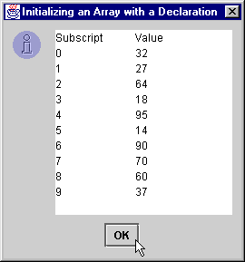
Usage

Slide 43
Notes
n is declared: its type is specified
  int n[]
n is allocated memory with new
  n = new int[10];
n.length
  length always holds the length of the array object (i.e. 10 in this case)
continued

Slide 44
The use of an option pane to display the text area is a quick way to display a single output GUI in a Java application
Compare with SquareInt.java
(slides 24-26) which puts a text area into a Java applet window
  it uses the applet’s content pane

Slide 45
4.3. Passing Arrays to Methods
Arrays are Java objects
  they are passed to methods using
  call-by-reference
  i.e. changes to an array inside a method
  affects the original
  no pointers required!

Slide 46
PassArray.java, Fig. 7.10, p.284
// Passing arrays and elements to methods
import java.awt.Container;
import javax.swing.*;
public class PassArray extends JApplet {
JTextArea outputArea;
String output;
public void init()
{
outputArea = new JTextArea();
Container c = getContentPane();
c.add( outputArea );
int a[] = { 1, 2, 3, 4, 5 };
:

Slide 47
output = "Effects of passing entire " +
"array call-by-reference:\n" +
"The values of the original
array are:\n";
for ( int i = 0; i < a.length; i++ )
output += " " + a[ i ];
// pass array call-by-reference
modifyArray( a );
output += "\n\nThe values of the modified
array are:\n";
for ( int i = 0; i < a.length; i++ )
output += " " + a[ i ];
:

Slide 48
output += "\n\nEffects of passing array " +
"element call-by-value:\n" +
"a[3] before modifyElement: " +
a[ 3 ];
modifyElement( a[3] );
output += "\na[3] after modifyElement: "
+ a[ 3 ];
// display all the output
outputArea.setText( output );
} // end of init()

Slide 49
b is an array
object, so passed
call-by-reference
public void modifyArray( int b[] )
// multiple each element by 2
{
for (int j = 0; j < b.length; j++)
b[j] *= 2;
}
public void modifyElement( int elem )
// multiple elem by 2
{
elem *= 2;
}
} // end of PassArray
elem is a
built-in type,
so passed
call-by-value

Slide 50
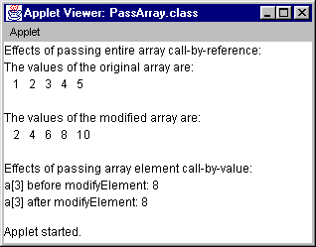
Use
changed
unchanged

Slide 51
Notes
This applet uses call-by-reference to change an entire array object, a
  it remains changed back in init()
It also tries to changes an array element, a[3], by using call-by-value (copying)
  it does not stay changed back in init()

Slide 52
Call-by-Reference Diagran
init()
modifyArray(int b[])
1
2
3
4
5
a object
reference
back to a
b object
:
modifyArray(a);
:
:
b[i] *= 2;
:

Slide 53
Call-by-Value Diagram
init()
modifyElement(int elem)
2
4
6
8
10
a object
8
elem
:
modifyElement( a[3]);
:
:
elem *= 2;
:
value is
copied
over

Slide 54
4.4. Multiple Subscript Arrays
For example: 2-D, 3-D arrays
  often needed for graphics (i.e. for matrices)
  similar to C

Slide 55
Declare and Initialise
Row-Column format:
  int coords[][] = new int[12][13];
  coords[0][0] = 1;
  coords[0][1] = 2;
Easier:
  int b[][] = {{1,2},{3,6}};
b
1
2
3
6

Slide 56
Arrays can have gaps:
  int c[][] = {{1,2},{3,4,5}};
undefined
(in C it would
be 0)
C
1
2
?
3
4
5
Dangerous; usually bad style

Slide 57
Lengths
c.length
  number of rows in c
c[0].length
  number of used columns in first row (i.e. 2)
c[1].length
  number of used columns in second row (i.e. 3)

Slide 58
A Common Coding Style
Sum an array:
  int total = 0;
  for(int row=0; row < c.length; row++)
  for(int col=0; col< c[row].length; col++)
  total += c[row][col];

Slide 59
4.5. A Different Syntax
Instead of:
  int temps[] = new int[13];
Can write:
  int[] temps = new int[13];

